Slide 1

MENARK FIRE EMERGENCY SIMULATION:
Experience a Safer Tomorrow with Virtual Reality Fire Emergency Simulations
By Bismark Buernortey Buer

Slide 2

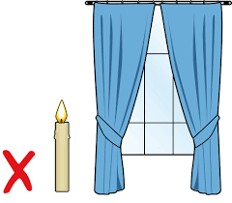
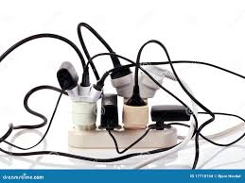

In emergency preparedness, Virtual Reality (VR) is a transformative tool for fire emergency simulations. Unlike traditional drills, VR offers an immersive experience, honing critical skills and fostering effective decision-making. Exploring the virtual realm enhances preparedness, ensuring a proactive response to real-world crises with increased safety and reduced panic.

Slide 3
This project uses VR technology to create realistic fire emergency simulations. Users can practice fire safety procedures in a safe environment. The user has three options to use to navigate the game

Slide 4
USER ONBOARDING
When the game is started, user will be immersed in a virtual room with fire, smoke, and sounds of fire alarms all over depicting an actual fire emergency. A black surface with some information introduces the game to the user. Below that are options for navigation.
OPTIONS:
Call 911
Use Fire Extinguisher
Home Fire Hazards
Quit

Slide 5
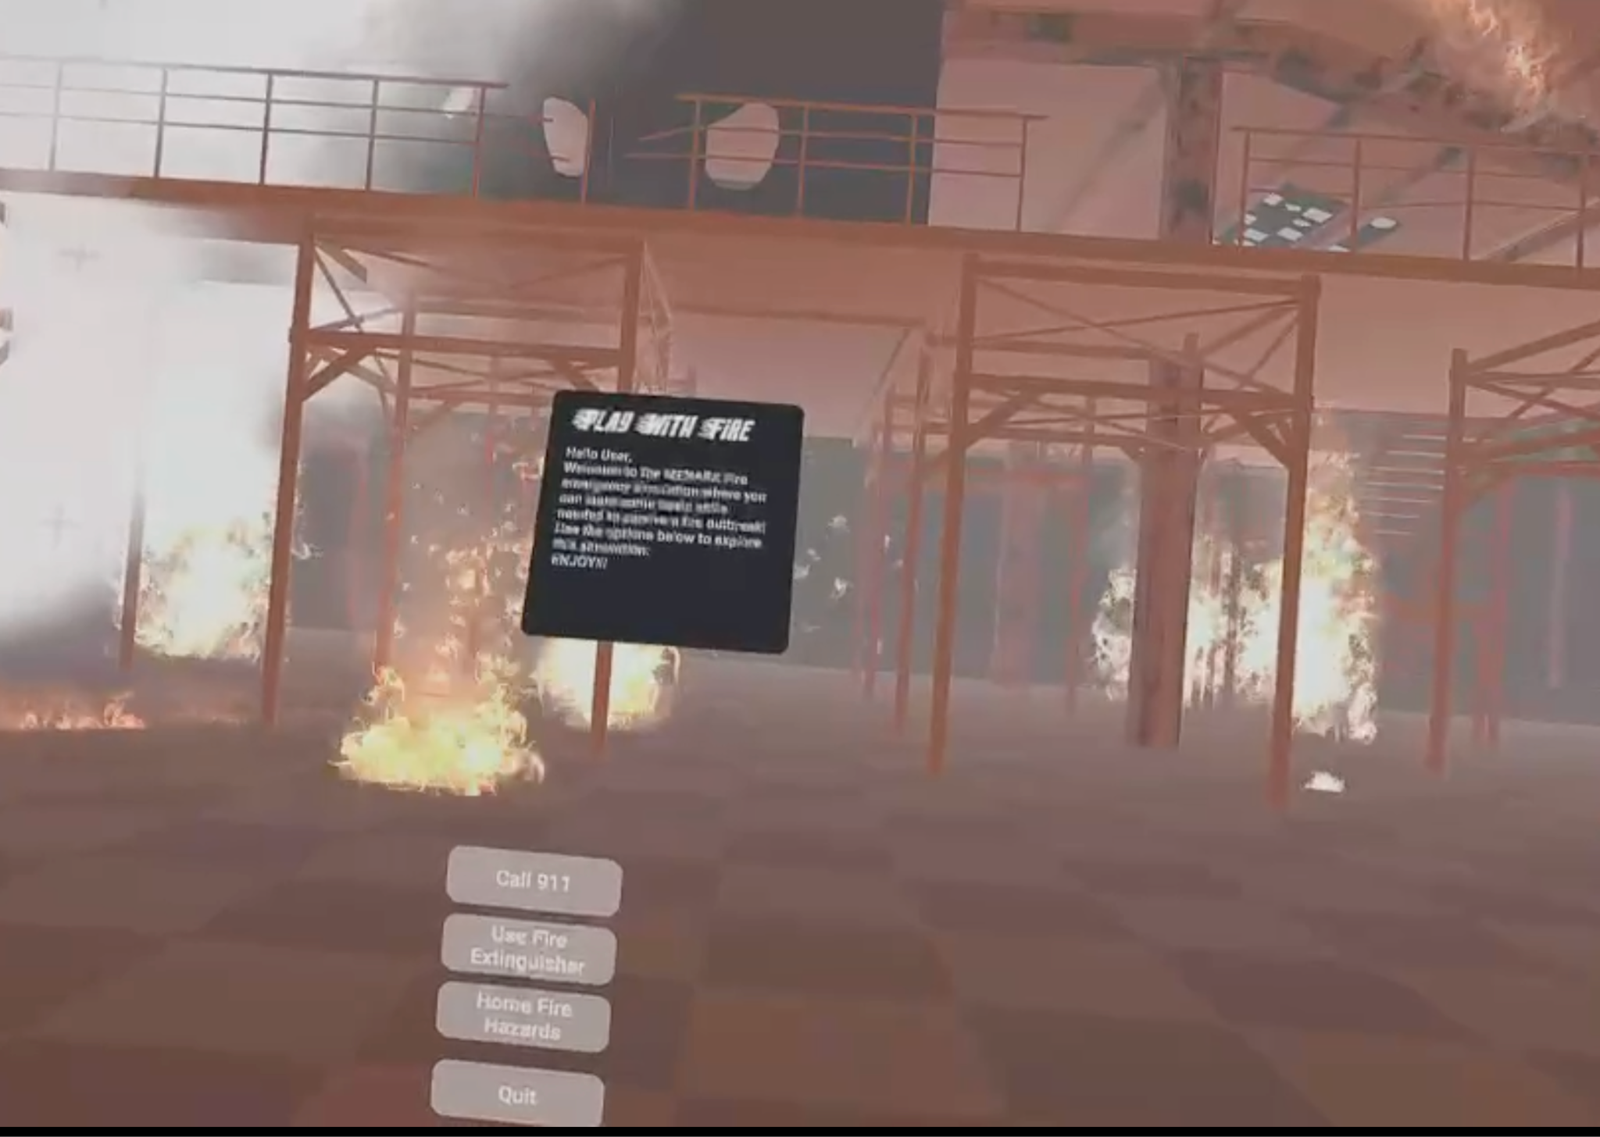
MAIN SCENE
TOOLS AND ASSETS:
A 3D warehouse
Fire extinguisher
UI clickables
Fire and smoke particles
Fire alarms
IMPLEMENTATION
A new unity project is created and 3D warehouse is added. Fire and smoke particles are imported and added to the project. A fire alarm sound is added to the background and looped to make it sound continuously.

Slide 6
01
Call 911
This option simulates an interactive call with 911 during a fire emergency. Users have some few seconds after each question to answer the questions.

Slide 7
OPTION 1 IMPLEMENTATION
A 911 audio clip made with eleven labs was imported into Unity and an empty GameObject called “AudioPlayer” was set up with an AudioSource to handle audio playback. A C# script called ButtonScripts was integrated into unity which has a reference to the AudioPlayer Gameobject. Clicking the Call 911 option will activate the AudioPlayer Gameobject to play the audio.
TOOLS AND ASSETS:
Eleven labs for voice over
Fire alarms
C# script

Slide 8
C# SCRIPT THAT MAKES THE 911 CALL HAPPENS WHEN THE CALL 911 OPTION IS SELECTED
using System.Collections;
using System.Collections.Generic;
using UnityEngine;
public class ButtonScripts : MonoBehaviour
{
public GameObject AudioPlayer;
// Start is called before the first frame update
public void playAudio()
{
AudioPlayer.SetActive(true);
}
}

Slide 9

02
Fire Extinguisher
This option helps user to learn how to use a fire extinguisher to quench fire during a fire outbreak.

Slide 10

Adding the objects
Objects used:
White smoke
Fire extinguisher
The smoke and the fire have a parent-child relationship.The smoke is dragged onto the fire extinguisher in the hierarchy window and its position is adjusted so it looks like it is coming out of the fire extinguisher and moves with it.

Slide 11
Interaction between smoke and fire
Setting up the scene
Assigned box colliders to each fire object and the smoke object.
Adjusted the size of these box colliders to match their approximate volumes.
Scripts
Tagging fire objects

Slide 12
using System.Collections;
using System.Collections.Generic;
using UnityEngine;
public class FireExtinguisher : MonoBehaviour
{
public GameObject fireExtinguisher;
// Start is called before the first frame update
public void ShowFireExtinguisher()
{
fireExtinguisher.SetActive(true);
}
}

Slide 13
Script 2:
if (other.gameObject.CompareTag("fire"))
{
// Debug log to indicate a fire object has been detected
Debug.Log(“Fire detected and being extinguished: " + other.gameObject.name);
// Remove or disable the fire game object
// You can also add custom logic here to handle the fire extinguishing effect
Destroy(other.gameObject);
// Debug log to confirm the fire object has been removed
Debug.Log("Fire extinguished: " + other.gameObject.name);
}
else {
{ // Debug log if the object is not tagged as "Fire"
Debug.Log("Collided with a non-fire object: " + other.gameObject.name);
}
using UnityEngine;
public class FireKiller : MonoBehaviour
{
// Start is called before the first frame update
void Start()
{
// Debug log to check if the script is running
Debug.Log("FireKiller script attached and running.");
}
// OnTriggerEnter is called when the Collider 'other' enters the trigger
private void OnTriggerEnter(Collider other)
{
// Check if the collided object has the tag "Fire"

Slide 14
03
HOME FIRE HAZARD potential common dangers
The user enters a living room. The user will see a welcoming message telling them that they should find three fire safety Hazards by pointing to the three objects. They are given hints for each. When the user points towards each of the correct object, they will hear a tick buzz sound and a message will appear informing why this is a wrong habit and why it can cause a fire.
The scene: a living room
The three correct objects: a candle near curtains, heater near newspaper, and overplugged Power Strip.

Slide 15
hazard manager
using UnityEngine;
using TMPro;
public class HazardManager : MonoBehaviour
{
// Reference to the TextMeshPro UI component
public TextMeshProUGUI messageText;
// Total number of correct hazards in the scene
private int totalCorrectHazards = 3;
// Number of correctly identified hazards
private int identifiedCorrectHazards = 0;

Slide 16
// Call this when a correct hazard is selected
public void CorrectHazardSelected(string message)
{
identifiedCorrectHazards++;
messageText.text = message;
// Check if all correct hazards have been identified
if (identifiedCorrectHazards == totalCorrectHazards)
{
messageText.text = "All fire hazards are cleared!";
}
}
// Call this when a wrong hazard is selected
public void WrongHazardSelected()
{
messageText.text = "Sorry, wrong object.";
}
}

Slide 17
Hazard detector
using UnityEngine; public class HazardDetector : MonoBehaviour { // Indicates whether this is a correct hazard public bool isCorrectHazard; public GameObject AudioToPlay; // The specific message for this hazard if it's correct public string correctHazardMessage; // Reference to the HazardManager private HazardManager hazardManager; void Start() { // Find the HazardManager in the scene hazardManager = FindObjectOfType<HazardManager>(); }

Slide 18
Hazard detector continued:
private void OnTriggerEnter(Collider other) { // Check if the collider belongs to the player or the player's VR controller if (other.CompareTag("Player")) { // Notify the HazardManager about the interaction if (isCorrectHazard) { hazardManager.CorrectHazardSelected(correctHazardMessage); AudioToPlay.SetActive(true); } else { hazardManager.WrongHazardSelected(); } } } }

Slide 19
player controller
/** * PlayerController.cs * * This script is designed for controlling player movement and rotation using the Oculus Touch Controllers * in a Unity environment. The right thumbstick controls the player's forward, backward, left and right movements, * while the left thumbstick controls the player’s rotation. * * Usage: * Attach this script to the player object or the object intended to be controlled by the user. * Adjust the `speed` and `rotationSpeed` public fields as necessary to suit your game's needs. *
using UnityEngine; public class PlayerController : MonoBehaviour { public float speed = 3.0f; // Speed at which the player moves public float rotationSpeed = 55.0f; // Speed at which the player rotates

Slide 20
private void Update() { // Action Buttons on Right Controller if (OVRInput.GetDown(OVRInput.Button.One, OVRInput.Controller.RTouch)) { // Insert the action to be performed when the button is pressed } //----------------------------------- // Player Movement Code Begins //----------------------------------- // Gather input from the right thumbstick for movement Vector2 movementThumbstick = OVRInput.Get(OVRInput.Axis2D.SecondaryThumbstick); // Right-hand controller float moveHorizontal = -1*movementThumbstick.x; float moveVertical =-1* movementThumbstick.y; // Gather input from the left thumbstick for rotation Vector2 rotationThumbstick = OVRInput.Get(OVRInput.Axis2D.PrimaryThumbstick); // Left-hand controller float rotateHorizontal = rotationThumbstick.x; // Move the player forward, backward, left, or right Vector3 movement = new Vector3(moveHorizontal, 0, moveVertical) * speed * Time.deltaTime; transform.Translate(movement, Space.World); // Rotate the player left or right based on the horizontal input from the left thumbstick float rotation = rotateHorizontal * rotationSpeed * Time.deltaTime; transform.Rotate(0, rotation, 0); //----------------------------------- // Player Movement Code Ends //----------------------------------- } }

Slide 21

THANKS!
Embrace the future of emergency preparedness with Virtual Reality Fire Emergency Simulations. Beyond traditional training, VR simulations offer an immersive, dynamic, and realistic approach to ensuring our safety. Let's continue to learn, adapt, and stay prepared for a safer tomorrow.
Thank you !!
Please keep this slide for attribution.

Slide 22
RESOURCES
https://www.firemiddleeastmag.com/over-2000-fires-in-the-uae-last-year-resulted-in-nine-deaths-and-89-injuries/#:~:text=Official%20figures%20have%20shown%20that,were%20firefighters%20attending%20the%20scene
https://youtu.be/QYBVHJm6tS4?si=i-rQyd2ZLJ5iEXIF
https://skfb.ly/oKQvN
https://youtu.be/GdwhlKKw0Lc?si=08LB2iQYWMKfclGq
https://assetstore.unity.com/packages/3d/props/fire-extinguisher-21147
https://elevenlabs.io/
https://voicechanger.io/

Slide 23
